Slide 1
COMP6049 – Algorithm Design and Analysis
Topic 17 – Huffman Code

Slide 2
Outline Materials
Concept of compression technique language
Introduction to Huffman code
Building Huffman tree
Creating Huffman Code table based on Huffman tree

Slide 3
DATA COMPRESSION
How does a compression program really work?
Why can size of file be reduced without reducing its contain?
Supposed we will store letter A. Computer recognizes the letter as a character with sequence 65, then the letter is stored in harddisk as 1000001 (binary number of 65 decimal). It needs 7 binary digit to store letter A.
Data compression tries to store as minimum as possible number of binary digits.

Slide 4
ENCODING CHARACTER
ASCII (American Standard Code for Information Interchange)
ASCII character encoding consists 128 characters; 7 bit binary numbers; printed 95 characters and 33 command character.
ISO 8859-1 is a standard character with 8 bit, can store 256 characters.
This standar is called as character encoding Latin-1.
UTF-8 (Unicode Transformation Format) is a standard encoding character that enable many languages as shown in the same time. Number of bit to store a character is different.
ASCII character is stored in 1 byte (8 bit).
Latin, Greek, Cyrillic, Armenian, Hebrew, Arabic, Syriac dan Thaana character is stored in 2 byte (16 bit).
Other laguages character is stored in 3 byte (24 bit). Character of Jawa/Bali (hanacaraka alphabetic) dan Bugis from Indonesia exist in this standard.
In the future it is possible to store character in 4 byte.

Slide 5
CHARACTER TABLE
Binary | # | C |  | Binary | # | C |  | Binary | # | C
0010 0000 | 32 | sp |  | 0100 0000 | 64 | @ |  | 0110 0000 | 96 | `
0010 0001 | 33 | ! |  | 0100 0001 | 65 | A |  | 0110 0001 | 97 | a
0010 0010 | 34 | " |  | 0100 0010 | 66 | B |  | 0110 0010 | 98 | b
0010 0011 | 35 | # |  | 0100 0011 | 67 | C |  | 0110 0011 | 99 | c
0010 0100 | 36 | $ |  | 0100 0100 | 68 | D |  | 0110 0100 | 100 | d
0010 0101 | 37 | % |  | 0100 0101 | 69 | E |  | 0110 0101 | 101 | e
0010 0110 | 38 | & |  | 0100 0110 | 70 | F |  | 0110 0110 | 102 | f
0010 0111 | 39 | ' |  | 0100 0111 | 71 | G |  | 0110 0111 | 103 | g
0010 1000 | 40 | ( |  | 0100 1000 | 72 | H |  | 0110 1000 | 104 | h
0010 1001 | 41 | ) |  | 0100 1001 | 73 | I |  | 0110 1001 | 105 | i
0010 1010 | 42 | * |  | 0100 1010 | 74 | J |  | 0110 1010 | 106 | j
0010 1011 | 43 | + |  | 0100 1011 | 75 | K |  | 0110 1011 | 107 | k
0010 1100 | 44 | , |  | 0100 1100 | 76 | L |  | 0110 1100 | 108 | l
0010 1101 | 45 | - |  | 0100 1101 | 77 | M |  | 0110 1101 | 109 | m
0010 1110 | 46 | . |  | 0100 1110 | 78 | N |  | 0110 1110 | 110 | n
0010 1111 | 47 | / |  | 0100 1111 | 79 | O |  | 0110 1111 | 111 | o
0011 0000 | 48 | 0 |  | 0101 0000 | 80 | P |  | 0111 0000 | 112 | p
0011 0001 | 49 | 1 |  | 0101 0001 | 81 | Q |  | 0111 0001 | 113 | q
0011 0010 | 50 | 2 |  | 0101 0010 | 82 | R |  | 0111 0010 | 114 | r
0011 0011 | 51 | 3 |  | 0101 0011 | 83 | S |  | 0111 0011 | 115 | s
0011 0100 | 52 | 4 |  | 0101 0100 | 84 | T |  | 0111 0100 | 116 | t
0011 0101 | 53 | 5 |  | 0101 0101 | 85 | U |  | 0111 0101 | 117 | u
0011 0110 | 54 | 6 |  | 0101 0110 | 86 | V |  | 0111 0110 | 118 | v
0011 0111 | 55 | 7 |  | 0101 0111 | 87 | W |  | 0111 0111 | 119 | w
0011 1000 | 56 | 8 |  | 0101 1000 | 88 | X |  | 0111 1000 | 120 | x
0011 1001 | 57 | 9 |  | 0101 1001 | 89 | Y |  | 0111 1001 | 121 | y
0011 1010 | 58 | : |  | 0101 1010 | 90 | Z |  | 0111 1010 | 122 | z
0011 1011 | 59 | ; |  | 0101 1011 | 91 | [ |  | 0111 1011 | 123 | {
0011 1100 | 60 | < |  | 0101 1100 | 92 | \ |  | 0111 1100 | 124 | |
0011 1101 | 61 | = |  | 0101 1101 | 93 | ] |  | 0111 1101 | 125 | }
0011 1110 | 62 | > |  | 0101 1110 | 94 | ^ |  | 0111 1110 | 126 | ~
0011 1111 | 63 | ? |  | 0101 1111 | 95 | _

Slide 6
HUFFMAN ALGORITHM
Invented by David A. Huffman in 1951 when he studied his Ph.D at Massachusetts Institute of Technology (MIT).
He discovered a method to build binary tree based on frequency. The Binary Tree is called as Huffman Tree is foundation of data compression with ZIP format.
The technique is used as algorithm to create JPEG image and musical file format MP3.

Slide 7
CREATING A HUFFMAN TREE
Sort characters from the smalest frequency in a table.
Choose top 2 characters, make as leaf node of the tree. Node the character and its frequency.
Make new node as parent of the two leaf nodes. Its fequency comes from both children.
Remove used nodes from the table.
Enter new node to the table.
Repeat step 2 until all nodes removed.
Beside contains bit data, table that contains Huffman Code has to be saved in order to re-translate.

Slide 8
EXAMPLE CASE
Supposed we store words:
LOGIKA ALGORITMA
Then, frequency table is:
K | R | T | M | sp | L | O | G | I | A
1 | 1 | 1 | 1 | 1 | 2 | 2 | 2 | 2 | 3

Slide 9
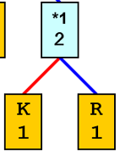
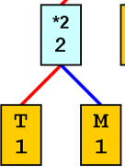
HUFFMAN TREE
K | R | T | M | sp | L | O | G | I | A
1 | 1 | 1 | 1 | 1 | 2 | 2 | 2 | 2 | 3
T | M | sp | *1 | L | O | G | I | A
1 | 1 | 1 | 2 | 2 | 2 | 2 | 2 | 3
sp | *1 | *2 | L | O | G | I | A
1 | 2 | 2 | 2 | 2 | 2 | 2 | 3

Slide 10
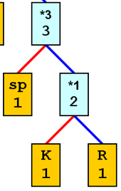
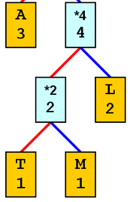
HUFFMAN TREE
sp | *1 | *2 | L | O | G | I | A
1 | 2 | 2 | 2 | 2 | 2 | 2 | 3
*2 | L | O | G | I | *3 | A
2 | 2 | 2 | 2 | 2 | 3 | 3
O | G | I | *3 | A | *4
2 | 2 | 2 | 3 | 3 | 4

Slide 11
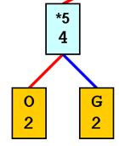
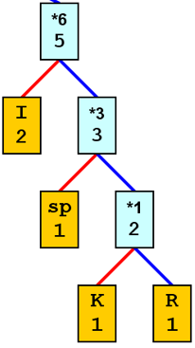
HUFFMAN TREE
O | G | I | *3 | A | *4
2 | 2 | 2 | 3 | 3 | 4
I | *3 | A | *4 | *5
2 | 3 | 3 | 4 | 4
A | *4 | *5 | *6
3 | 4 | 4 | 5

Slide 12
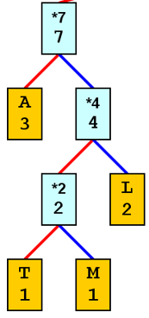
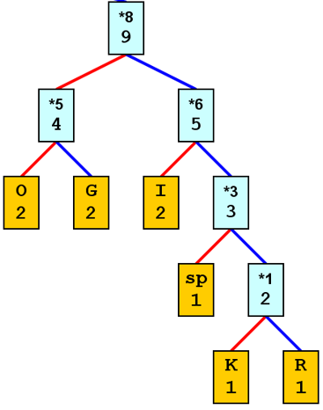
HUFFMAN TREE
A | *4 | *5 | *6
3 | 4 | 4 | 5
*5 | *6 | *7
4 | 5 | 7
*7 | *8
7 | 9

Slide 13
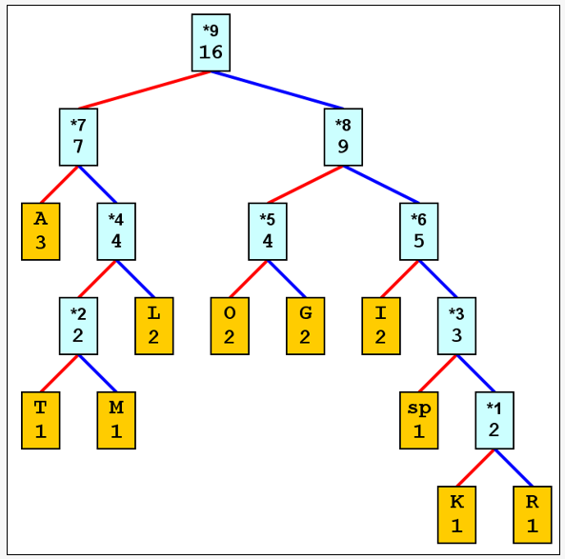
HUFFMAN TREE
*7 | *8
7 | 9
*9
16

Slide 14
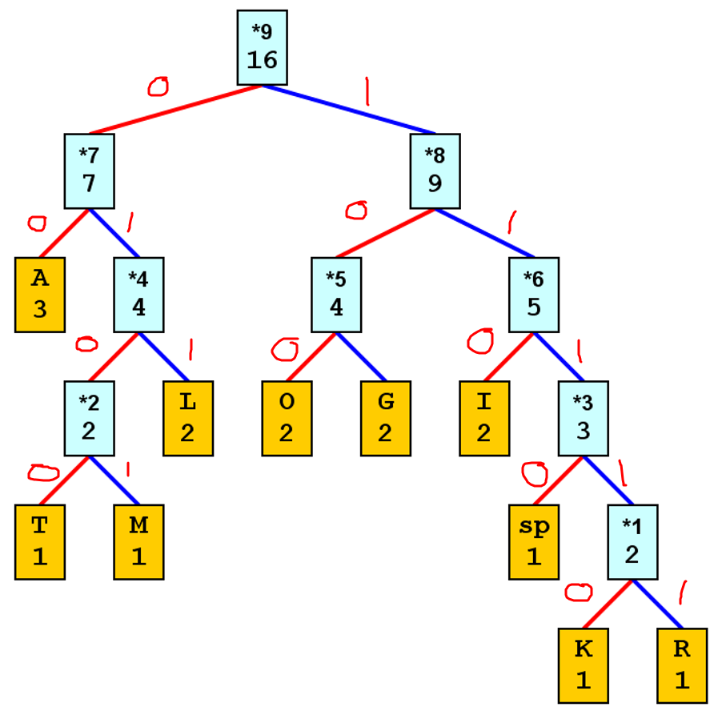
HUFFMAN TREE
Put 0 in the left
Put 1 in the right

Slide 15
HUFFMAN TREE
Use the value to build the Huffman Table
L 011
O 100
G 101
I 110
K 11110
A 00
sp 1110
A 00
L 011
G 101
O 100
R 11111
I 110
T 0100
M 0101
A 00

Slide 16
HUFFMAN CODE TABLE
Char | Count | Code | Total bits
K | 1 | 11110 | 5
R | 1 | 11111 | 5
T | 1 | 0100 | 4
M | 1 | 0101 | 4
sp | 1 | 1110 | 4
L | 2 | 011 | 6
O | 2 | 100 | 6
G | 2 | 101 | 6
I | 2 | 110 | 6
A | 3 | 00 | 6
 |  |  | 52

Slide 17
EXERCISE
Create frequency table,
Huffman Tree, and
Huffman Code to compress:
DESIGN AND ANALYSIS OF ALGORITHMS

Slide 18
REVIEW
DATA COMPRESSION
ENCODING CHARACTER
CHARACTER TABLE

Slide 19
Q & A

Slide 20
References
S. Sridhar. 2014. Design and Analysis of Algorithms, 1/e. Oxford University Press. India. Chapter 11
Ellis Horowitz,Sanguthevar Rajasekaran,Sartaj Sahni. 1998. Computer algorithms/C++. 1STBL. New York. Chapter 4.7
Huffman Coding http://www.huffmancoding.com/my-family/my-uncle/huffman-algorithm

Slide 21
THANK YOU

